Slide 1





Top layer/text
Oct 27, 2023
Episode Details
User Spotlight! DeltaSecure & hypervisors!
tv ‘noise’

Slide 2

Top layer/text
Oct 13, 2023
Episode Details
Working Session! Ahead of the All Things Open conference we’ll be looking at upgrading our demo! Coding go/python today.
tv ‘noise’

Slide 3


Top layer/text
Oct 06, 2023
Episode Details
Let’s look at the zrok SDK!!
tv ‘noise’

Slide 4


Top layer/text
Sep 29, 2023
Episode Details
Working Session and Office Hours!
tv ‘noise’

Slide 5
May 26, 2023
Episode Details
Office Hours and livestream

Slide 6

Top layer/text
Sep 22, 2023
Episode Details
User Spotlight! Cloud Underground
tv ‘noise’

Slide 7

Top layer/text
Sep 15, 2023
Episode Details
User Spotlight! ztsolutions.io
tv ‘noise’

Slide 8
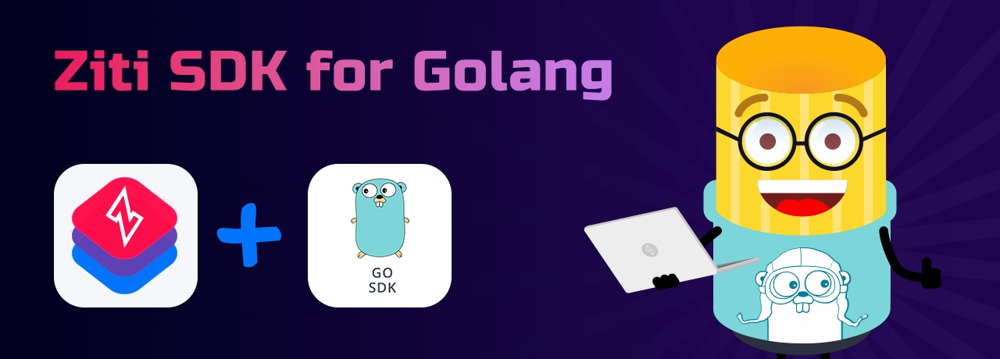
Sep 08, 2023
Episode Details
Automating OpenZiti and using the Golang SDK

Slide 9
Top layer/text
Sep 01, 2023
Episode Details
Link Groups!
tv ‘noise’

Slide 10

Top layer/text
Aug 25, 2023
Episode Details
User Spotlight! NetFoundry?!?!
tv ‘noise’

Slide 11
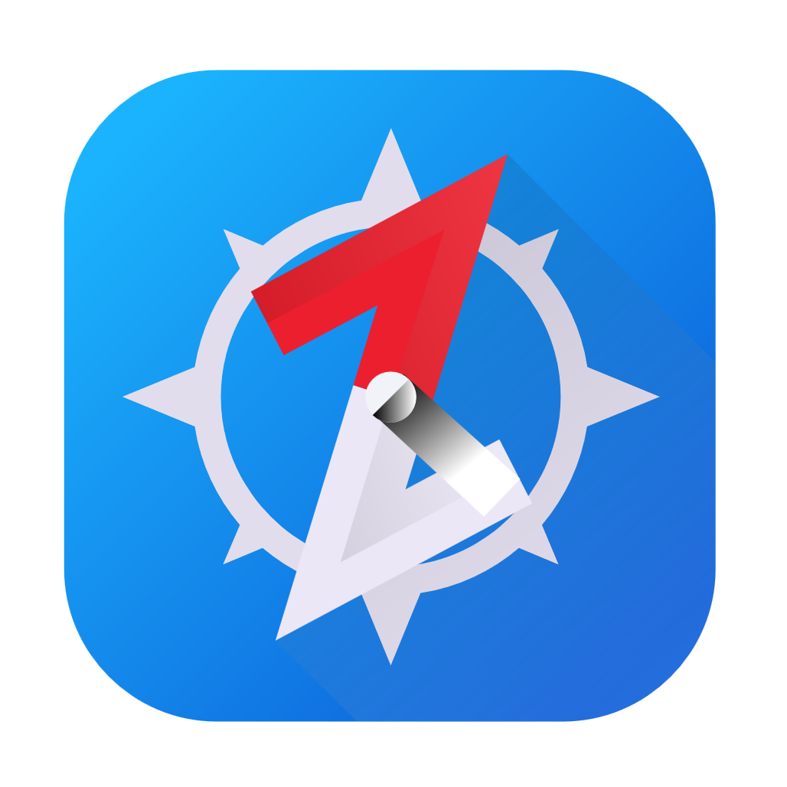
Aug 18, 2023
Episode Details
Let’s self-host BrowZer! (again)

Slide 12

Aug 4, 2023
Episode Details
zrok public beta!!!

Slide 13


Jul 21, 2023
Episode Details
Study Time
OpenZiti Overview!

Slide 14
What is Zero Trust
WHY Zero Trust
Anatomy of the overlay
Controller
Router
Tunnelers/clients/SDK
What’s a/an:
Service
Config
Service Policy
Identity
Study Time

Slide 15

Jul 14, 2023
Episode Details
User Spotlight! Analytics HQ!

Slide 16
Jun 23, 2023
Episode Details
Let’s self-host BrowZer!

Slide 17

Jun 23, 2023
Episode Details
User Spotlight! Paul Otto - RAFT

Slide 18
Jun 09, 2023
Episode Details
Just how DOES BrowZer work???

Slide 19
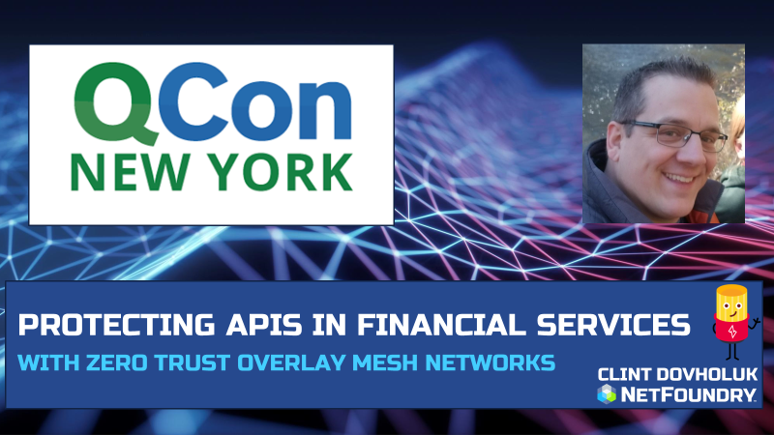
Jun 02, 2023
Episode Details
Securing APIs with OpenZiti and SPIRE! Application Embedded Zero Trust!

Slide 20
May 26, 2023
Episode Details
Office Hours and livestream

Slide 21


ZSSH with oidc!

Slide 22

Edgex Foundry + OpenZiti

Slide 23
Apr 28, 2023
Episode Details
Adding OpenZiti to microservice sample code

Slide 24


Apr 14, 2023
Episode Details
Even more zrok!!!
zrok in docker?
zrok in Kubernetes!?

Slide 25
Mar 31, 2023
Episode Details
OIDC, Keycloak, IdP, ext-jwt-signers

Slide 26
Mar 17, 2023
Episode Details
Working session: OpenZiti Network in Kubernetes!

Slide 27
Mar 10, 2023
Episode Details
Qcon 2023 Presentation

Slide 28

Mar 03, 2023
Episode Details
Monthly Forum

Slide 29
Feb 17, 2023
Episode Details
Release note read out
zrok in docker
zrok in Kubernetes!?

Slide 32


Slide 34
Feb 17, 2023
Episode Details
Release note read out
zrok in docker
zrok in Kubernetes!?

Slide 35
Feb 10, 2023
Episode Details
User Spotlight!

Slide 36
Feb 3, 2023
Episode Details
New container images!?

Slide 37
Jan 18, 2023
Episode Details
Javier Diaz from Jeju National University. Blockchain, OpenZiti and Intent-based networking

Slide 38
Dec 9, 2022
Episode Details
Release Notes:
0.21.11
Zitification – Beats!
SERPs

Slide 39
Jan 12, 2023
Episode Details
Monthly Ideas Forum

Slide 40
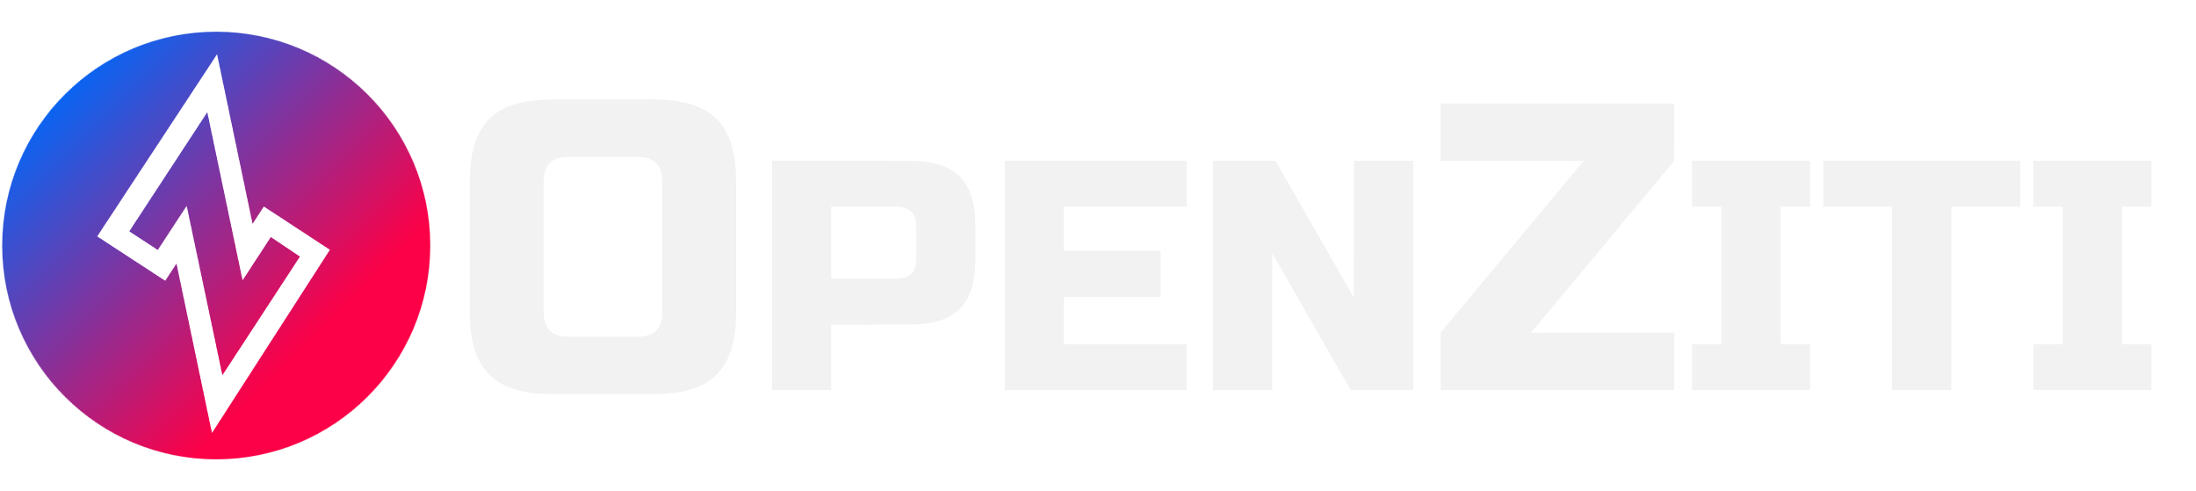

Nov 18, 2022
Episode Details
Release Notes:
0.26.11+
+

Slide 41
Nov 11, 2022
Episode Details
Release Notes:
0.26.11+
Looking at samples

Slide 42
Nov 04, 2022
Episode Details
Release Notes:
0.26.10+
BrowZer!!!

Slide 43
Oct 28, 2022
Episode Details
Release Notes:
0.26.10+
Working Session!

Slide 44
Oct 21, 2022
Episode Details
Release Notes:
0.26.10+
Config types – take 2!

Slide 45
Oct 07, 2022
Episode Details
Release Notes:
0.26.9+
Config types!

Slide 46
Sep 23, 2022
Episode Details
Release Notes:
0.26.8+
Linux UI/Packaging
Python SDK
Hacker News postings
other?

Slide 47
Sep 16, 2022
Release Notes:
0.26.5+
Multi-Region APIs with Kubernetes
Episode Details

Slide 48
Sep 09, 2022
Release Notes:
0.26.4+
VPN vs Zero Trust
User Experience
Episode Details

Slide 49
Sep 02, 2022
Release Notes:
0.26.4+
New ZDEW UI?
Episode Details

Slide 50
Aug 26, 2022
Release Notes:
0.26.4+
Custom PKI with OpenSSL?
Episode Details

Slide 51
Aug 12, 2022
Release Notes:
0.26.4+
CVE’s, Lambdas and OpenZiggy
Episode Details

Slide 52
Aug 05, 2022
Release Notes:
0.26.4+
ziti CLI and debugging
Episode Details

Slide 53
July 22, 2022
Release Notes:
0.26.2+
Application Embedded LDAP Client
Episode Details

Slide 54
July 15, 2022
Release Notes:
0.26.1+
Posture Checks
Episode Details

Slide 55
July 08, 2022
Release Notes:
0.26.1+
What is ‘zitify’?
Episode Details

Slide 56
July 01, 2022
Release Notes:
0.26.0+
Making ZAC and the Management API DARK!
Episode Details

Slide 57
June 17, 2022
Release Notes:
0.25.12+
Zitifying Ansible!?!?!
Episode Details

Slide 58
June 10, 2022
Release Notes:
0.25.11+
Python support and other SDK conversation
Episode Details

Slide 59
June 3, 2022
Release Notes:
None
Replacing SSH bastions with OpenZiti
Episode Details

Slide 60

June 3, 2022
Release Notes:
None
Replacing SSH bastions with OpenZiti
Episode Details

